Slide 1
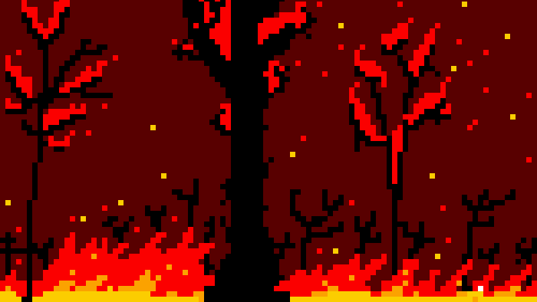
Versatile Vegetation
Reducing Percolation in Forest Fire Models
Seda, Keyuan, Akje and Reinout
Notes:
Akje

Slide 2
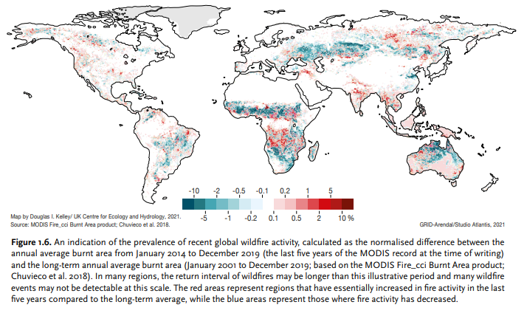
Introduction
Source: https://www.unep.org/resources/report/spreading-wildfire-rising-threat-extraordinary-landscape-fires
Climate change: warmer springs, longer summers, drier soils/vegetation
Existing measures: vegetation patterns, controlled burning, fire resistant plants
Notes:
Multiple studies have found that climate change has already led to an increase in wildfire season length, wildfire frequency, and burned area.2,3 The wildfire season has lengthened in many areas due to factors including warmer springs, longer summer dry seasons, and drier soils and vegetation.
https://www.unep.org/resources/report/spreading-wildfire-rising-threat-extraordinary-landscape-fires

Slide 3
Research question
How do the ignition chances and ratio of different vegetation types affect the percolation probability in a forest fire model?
Notes:
How does the forest density and ratio of different vegetation types affect the percolation probability in a forest fire model?
(Taking into account the interactions between the parameters, how can the percolation probability be reduced?
Akje

Slide 4
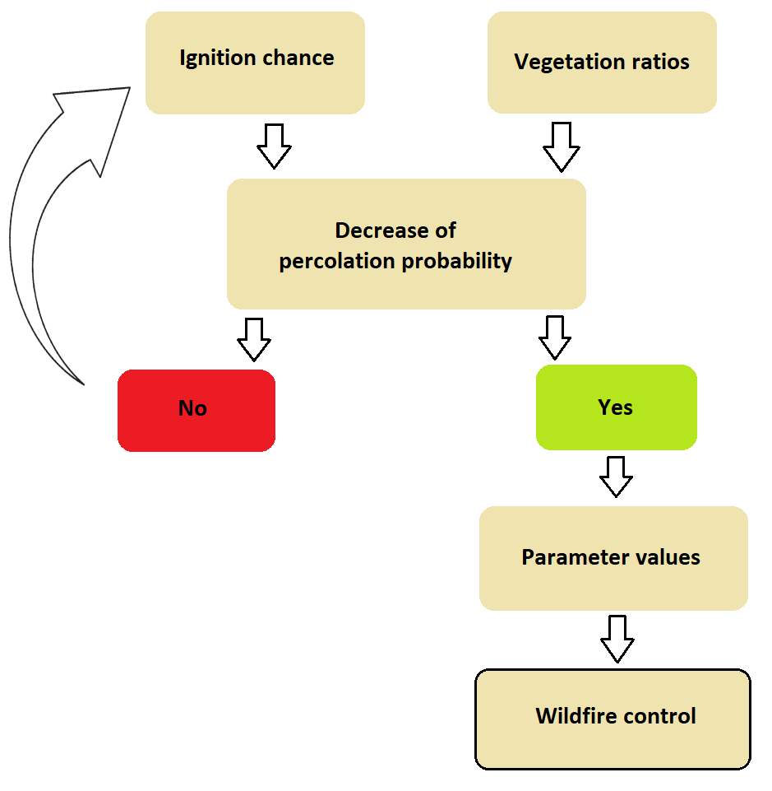
Hypothesis
Cell connectivity:
Lower density -> lower percolation
Optimum forest density and vegetation ratios
Notes:
Fire spread depends on the connectivity between cells. Thus, for lower forest densities and vegetation types with a lower ignition chance, the percolation chance is also lower.
(Not simply reducing forest density but finding an optimum between higher forest densities and ratios between different vegetation types)

Slide 5
Sidenote
Generally, deciduous (maple/oak) trees and plants are less flammable than conifers (pine/redwood)
Depends on resin composition, spatial structure, leaf humidity etc…¹
Our model parameters are based on this
Simplified model, yet captures general dynamics
Notes:
Clear idea of scientific value; what it does and doesn't achieve; assumptions are clear
https://www.canr.msu.edu/news/wildfire-resistant_landscape_plants_can_protect_your_home

Slide 6
Model implementation: parameters
dimension
cell states: EMPTY, PLANT, FIRE, BURNED
plant density
burnout time
neighbourhood
Moore
Von Neumann (optional)
max. 3 different plants: TREE, GRASS, SHRUB
ignition chance
humidity (optional)
layout: random, patterned (optional)
Notes:
Forest represented as a 2D grid
Grid cells: empty, plant, fire, or burned
Initial density of trees
Fire spreads to neighbors (Moore or Von Neumann) !added additional options!
Max 3 different plants with own ignition chance, humidity factor !added additional option!, and their layout can be random or patterned !added additional options!

Slide 7
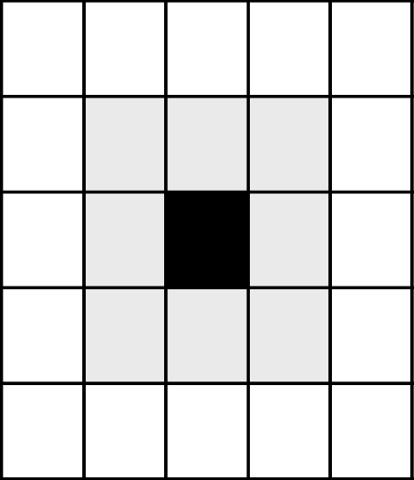
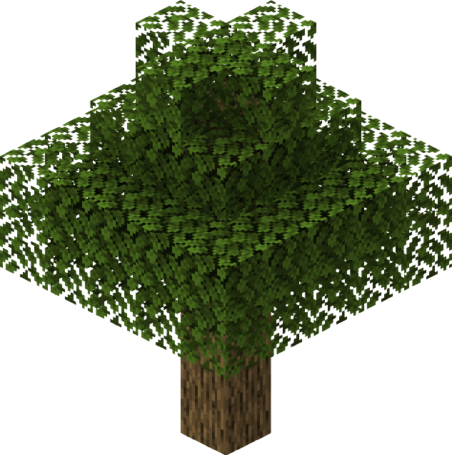
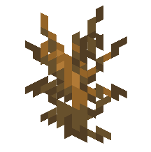
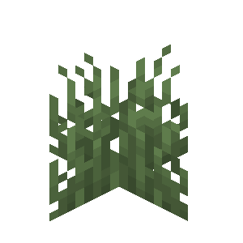
Model implementation: rules for fire spreading
fire chance = (total neighbours on fire / total neighbours) *
ignition * humidity
Notes:
Lightning strike hits a cell and starts fire
Fire spreads to neighbors
Probability of fire depends on burning neighbors, vegetation type, and humidity
draw a random number
Simulation ends when fires extinguished
No tree regrowth due to longer growth timescales

Slide 8
Experiments
When does the fire reach all edges?
percolation candidate
What percentage of the forest burns down?
Notes:
The goal for our experiments is then to look at when the fire reaches all edges; these are percolation candidates,
and what percentage of the forest burns down.

Slide 9
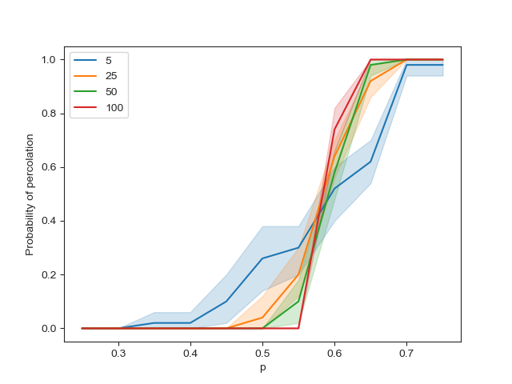
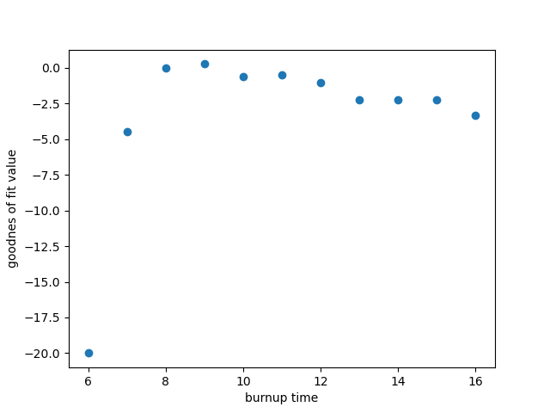
Fixed parameters:
dimension and burn out time
Notes:
Akje

Slide 10
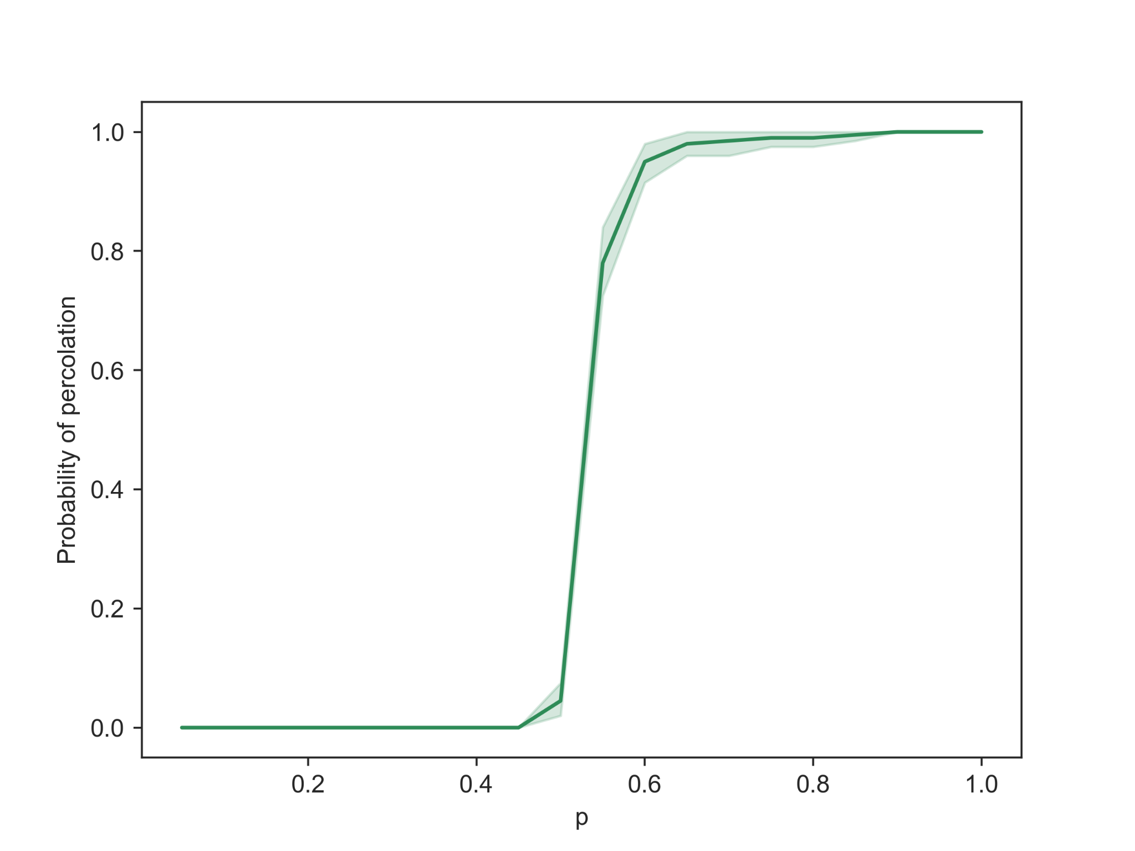
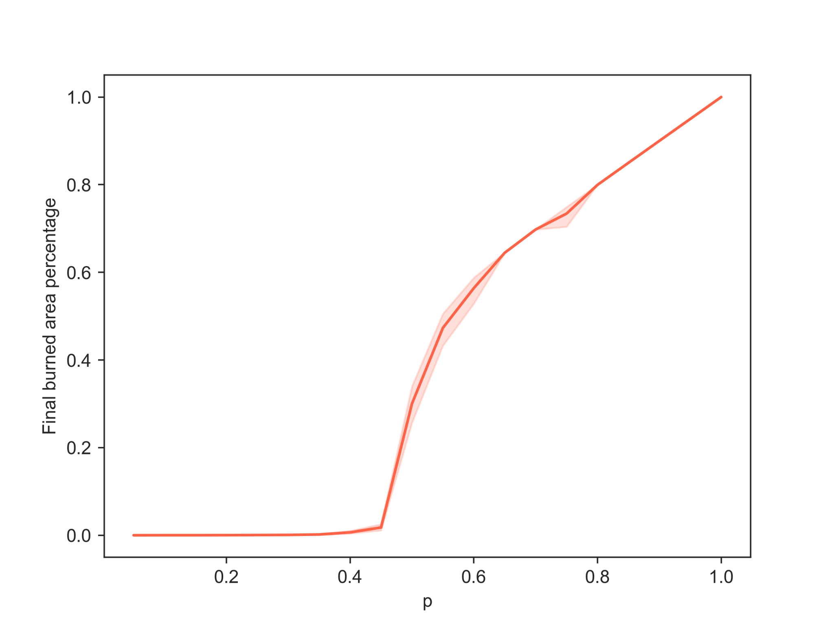
Results: default (single plant type)
p_c≈0.55
Only trees, ignition and humidity fixed at 1
Notes:
Let’s first look at how our model behaves in a default setting.
Burnout time = 10
Dimension = 100x100
Ignition = humidity = 1 (ruling out this effect)
Akje
errorbars show variance
left image: 10 experiments, 20 simulations per p
right image: 40 simulations

Slide 11
2 plant types: Intuition
How to prevent mixed vegetation from wildfire?
Control the ratio of plants? How?
Ignition probability fixed to 1.0 for one plant (tree)
Vary the ignition probability for the other plant (shrub)
Also vary the tree/shrub ratio
How does the average percolation probability change?
What about the average burned area?

Slide 12
2 plant type: Experiment settings
For each simulation: random grid initialization
For each experiment: 250 simulations
Take the average among those simulations (percolation probability & burned area)

Slide 13
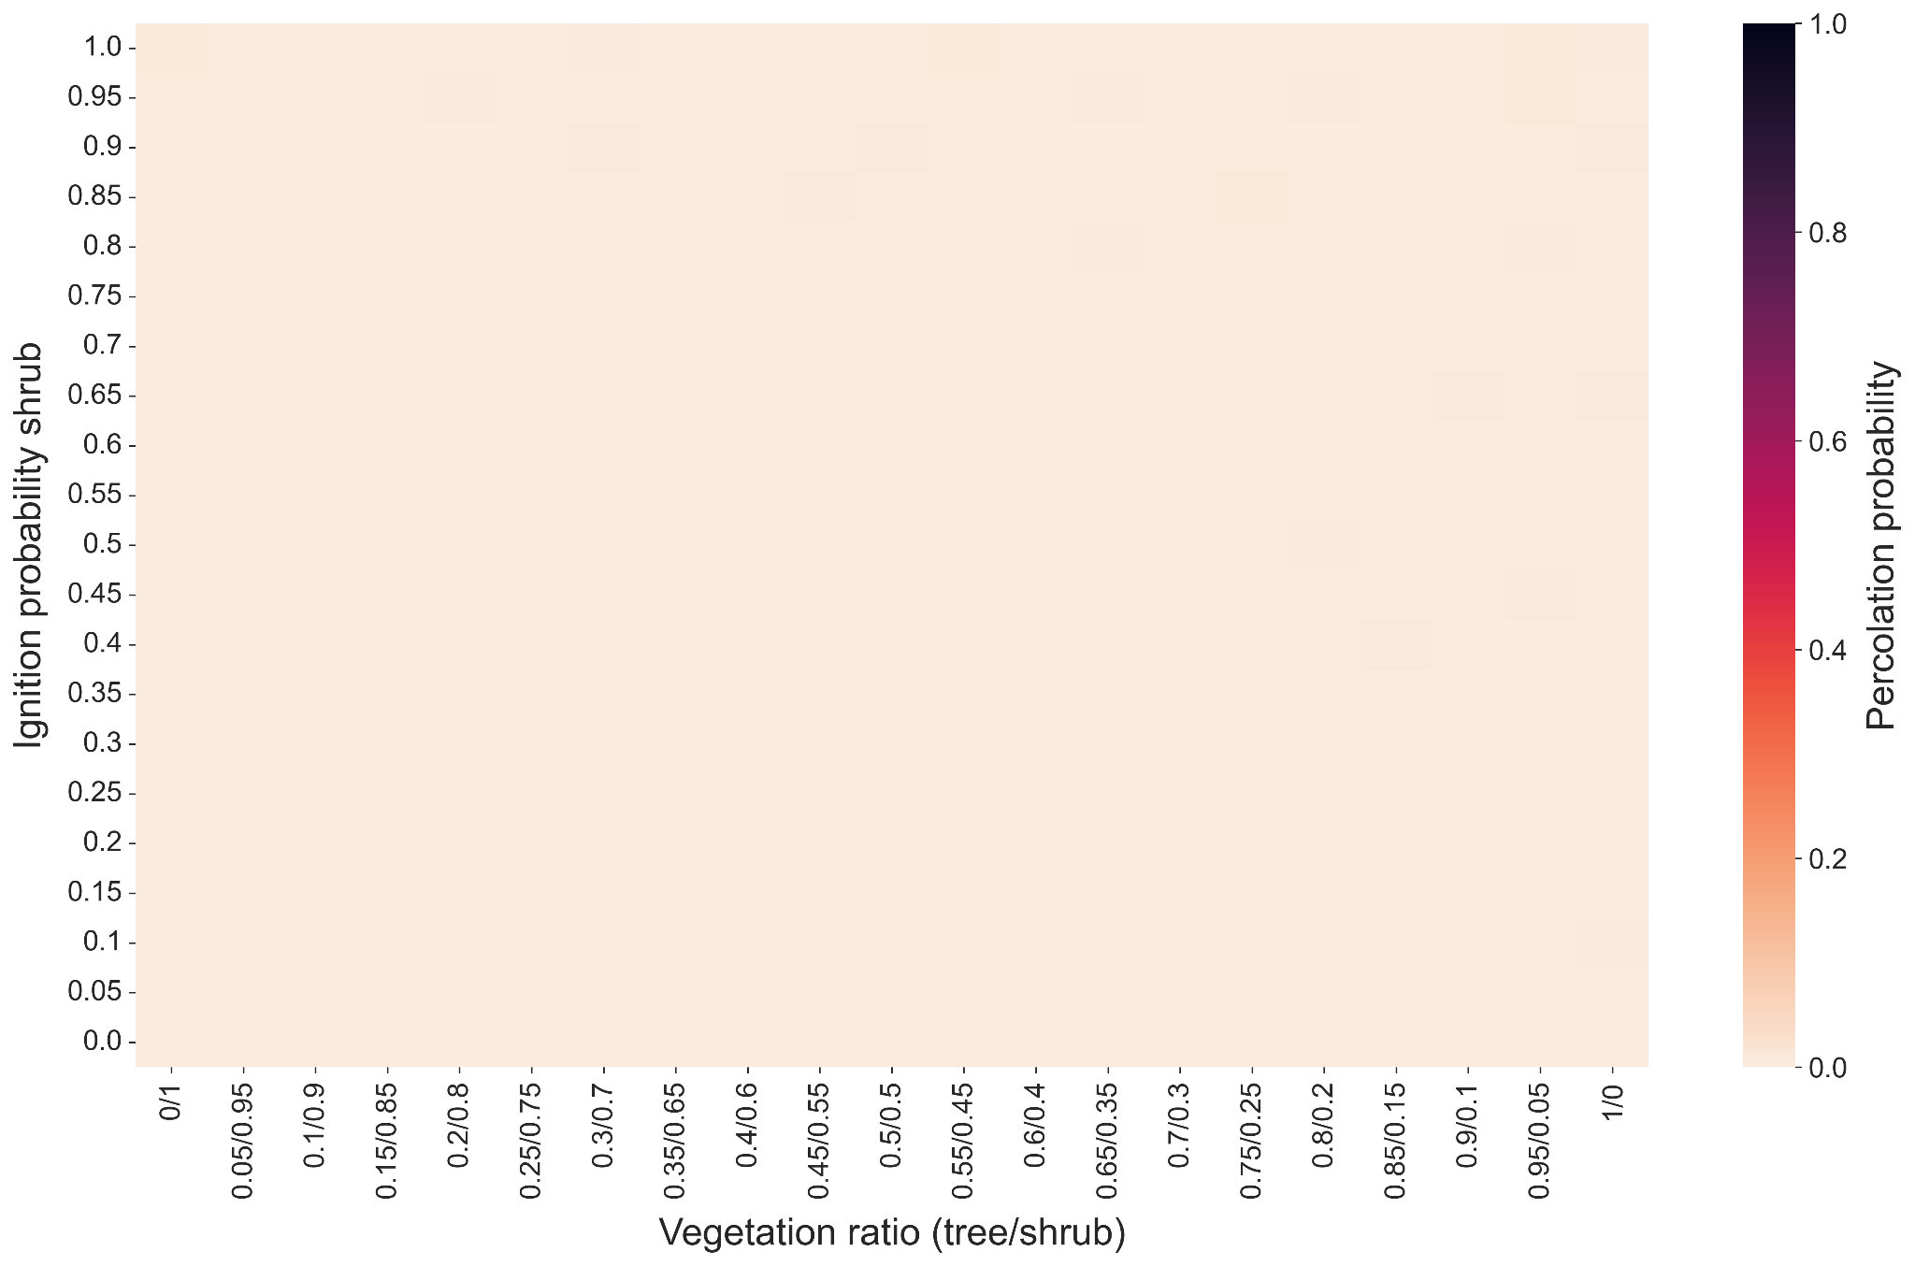
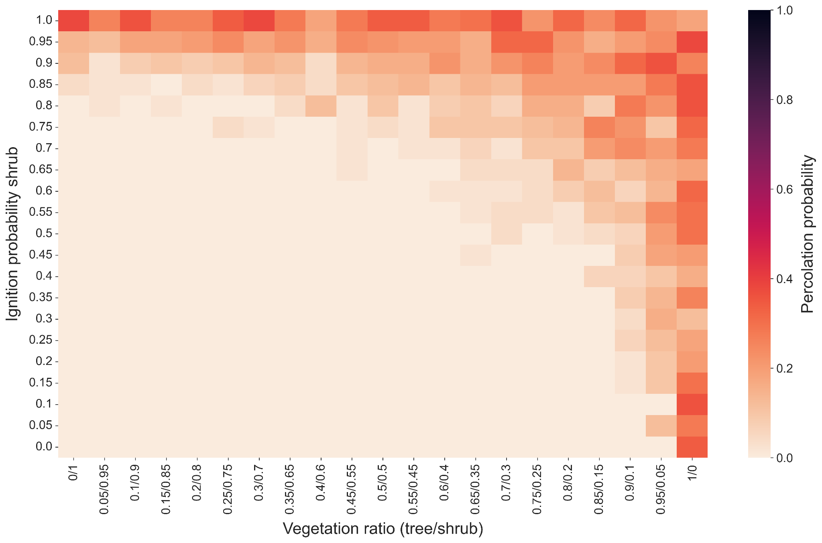
Results: Percolation probability
Density: 0.45
Density: 0.5

Slide 14
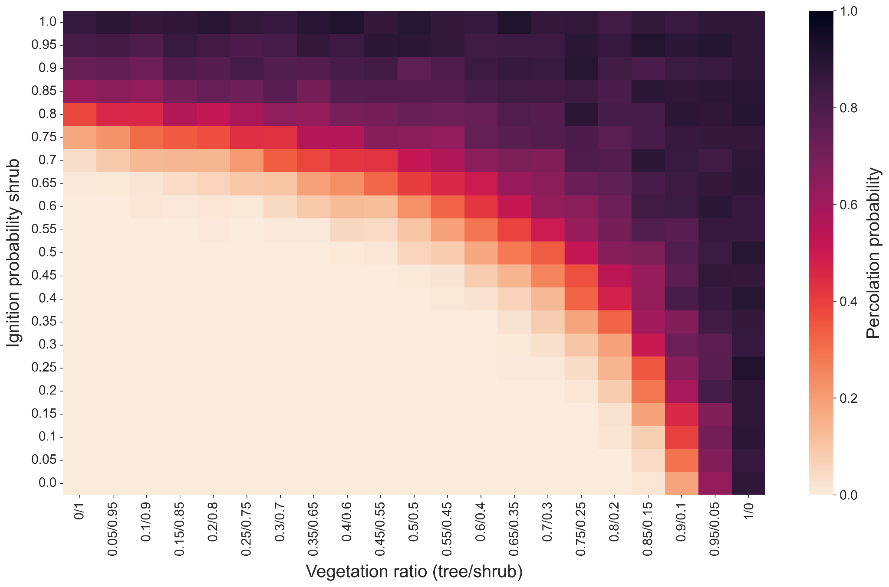
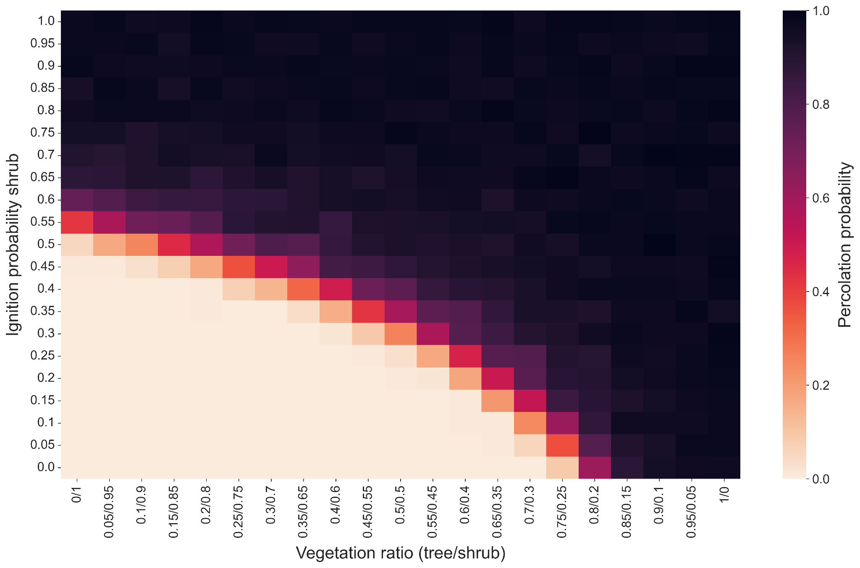
Results: Percolation probability
Density: 0.55
Density: 0.65

Slide 15
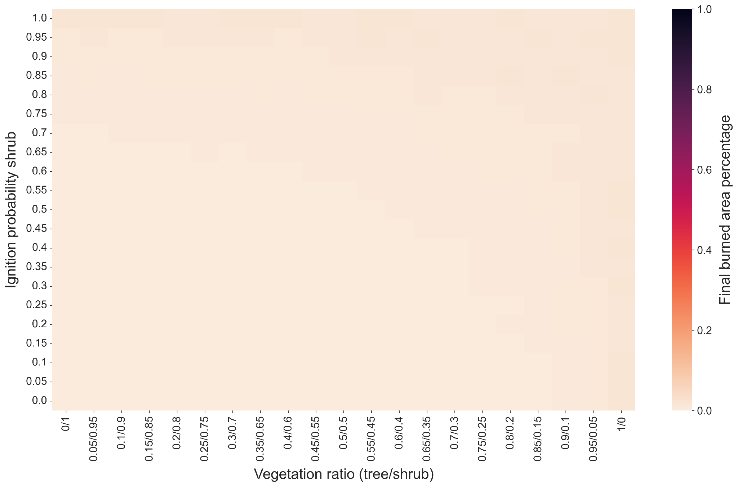
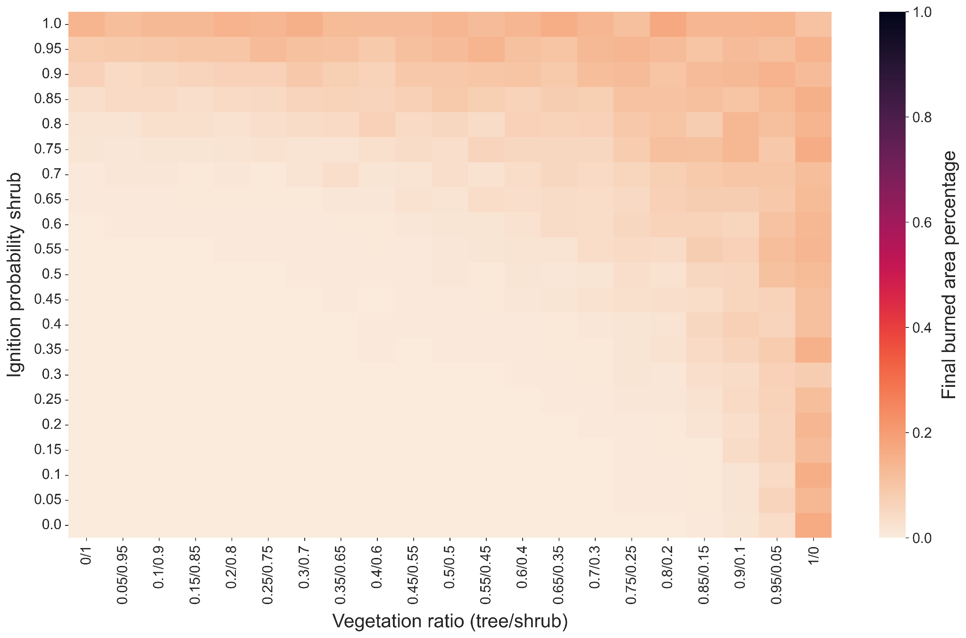
Results: Burned area percentage
Density: 0.45
Density: 0.5

Slide 16
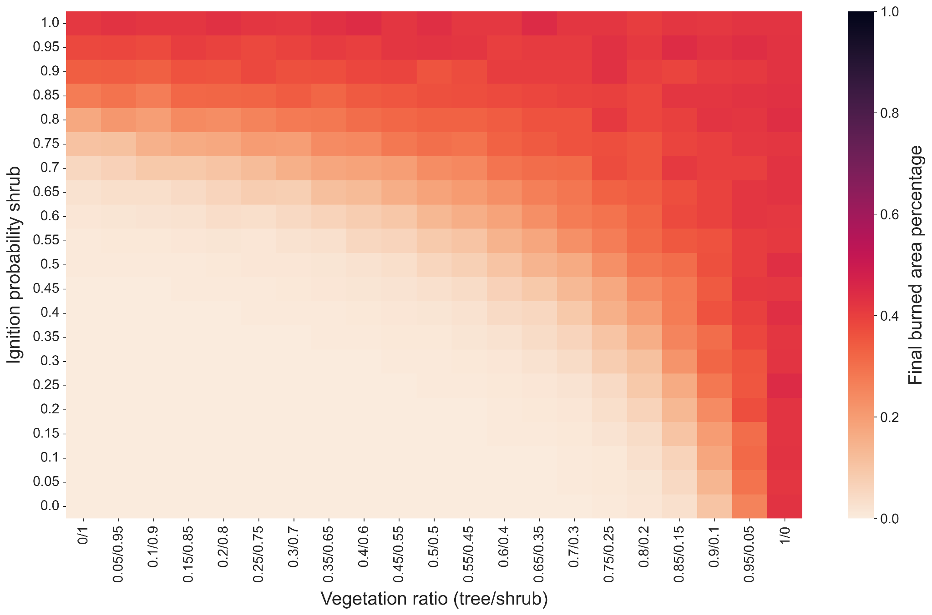
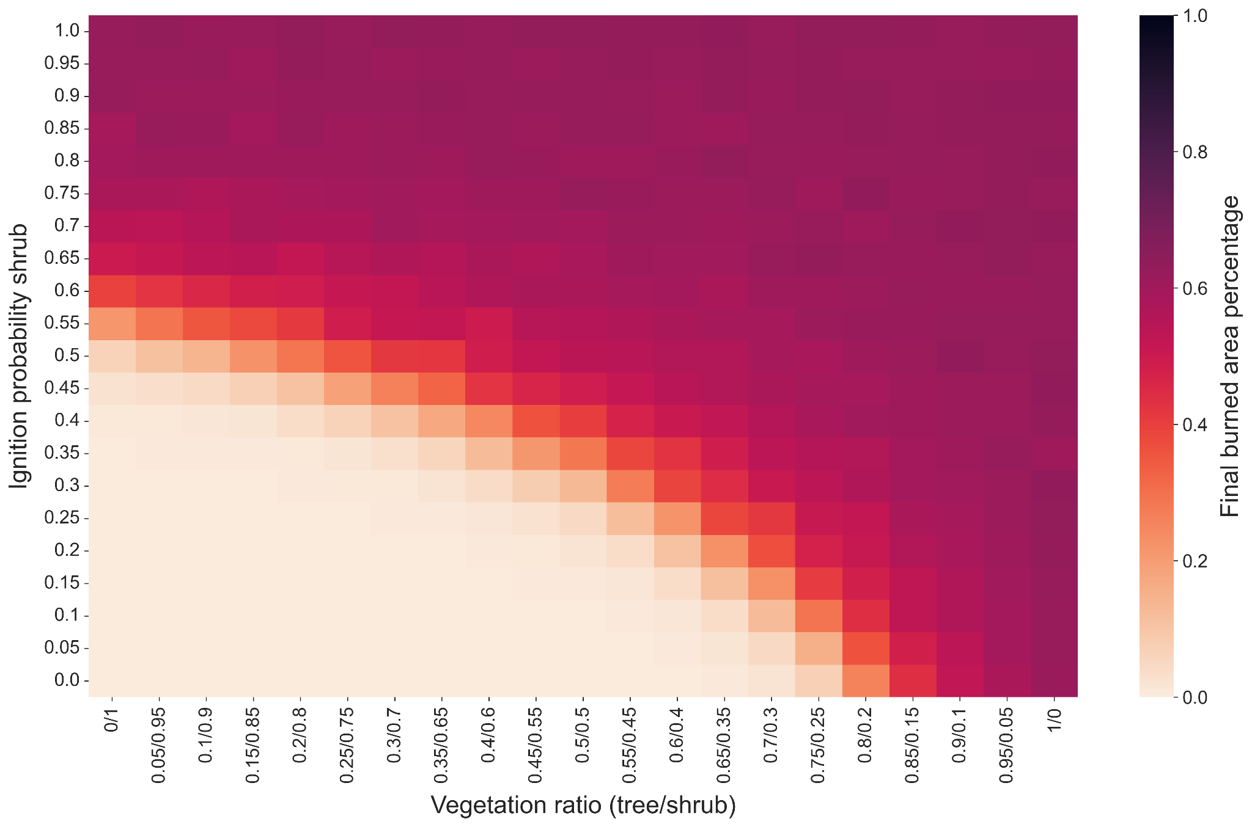
Results: Burned area percentage
Density: 0.55
Density: 0.65
Notes:
What can we interpret from these figures?
That is, with a fixed density, even higher than the critical density, we can prevent large scale wildfire from carefully selected vegetation type and vegetation ratio.

Slide 17
Summary of findings
Created a working forest fire model
Looked at the most important features
Created different percolation models consisting of plant ratio’s with different tree/shrub densities

Slide 18
Conclusion
The ignition chances have a positive correlation with the percolation probability.
Forest density is a key factor influencing percolation probability
Found out how the different ratio’s of plant sorts affected percolation probability.
Necessary to find the right balance that keeps the ecosystem running
Optimizing ratio of different plant species can diversify the forest while maintaining a low percolation probability

Slide 19
Future work
Implemented but not finished: humidity, wind, slope
Challenge: many degrees of freedom
Exploring the impact of plant biodiversity versus uniformity on percolation outcomes
Does a uniform plant grid yield different percolation probabilities compared to a diverse grid with equivalent average parameters?
Genetic Algorithm for finding optimal shapes for firebreaks (Homchaudhuri et al., 2009)
Notes:
HomChaudhuri, B, Zhao, S, Cohen, K, & Kumar, M. "Generation of Optimal Fire-Line for Fighting Wildland Fires Using Genetic Algorithms."

Slide 20
Questions?

Slide 21
References
HomChaudhuri, B., Zhao, S., Cohen, K., & Kumar, M. (2009, January). Generation of optimal fire-line for fighting wildland fires using genetic algorithms. In Dynamic Systems and Control Conference (Vol. 48920, pp. 111-118).

Slide 22
Appendix

Slide 23
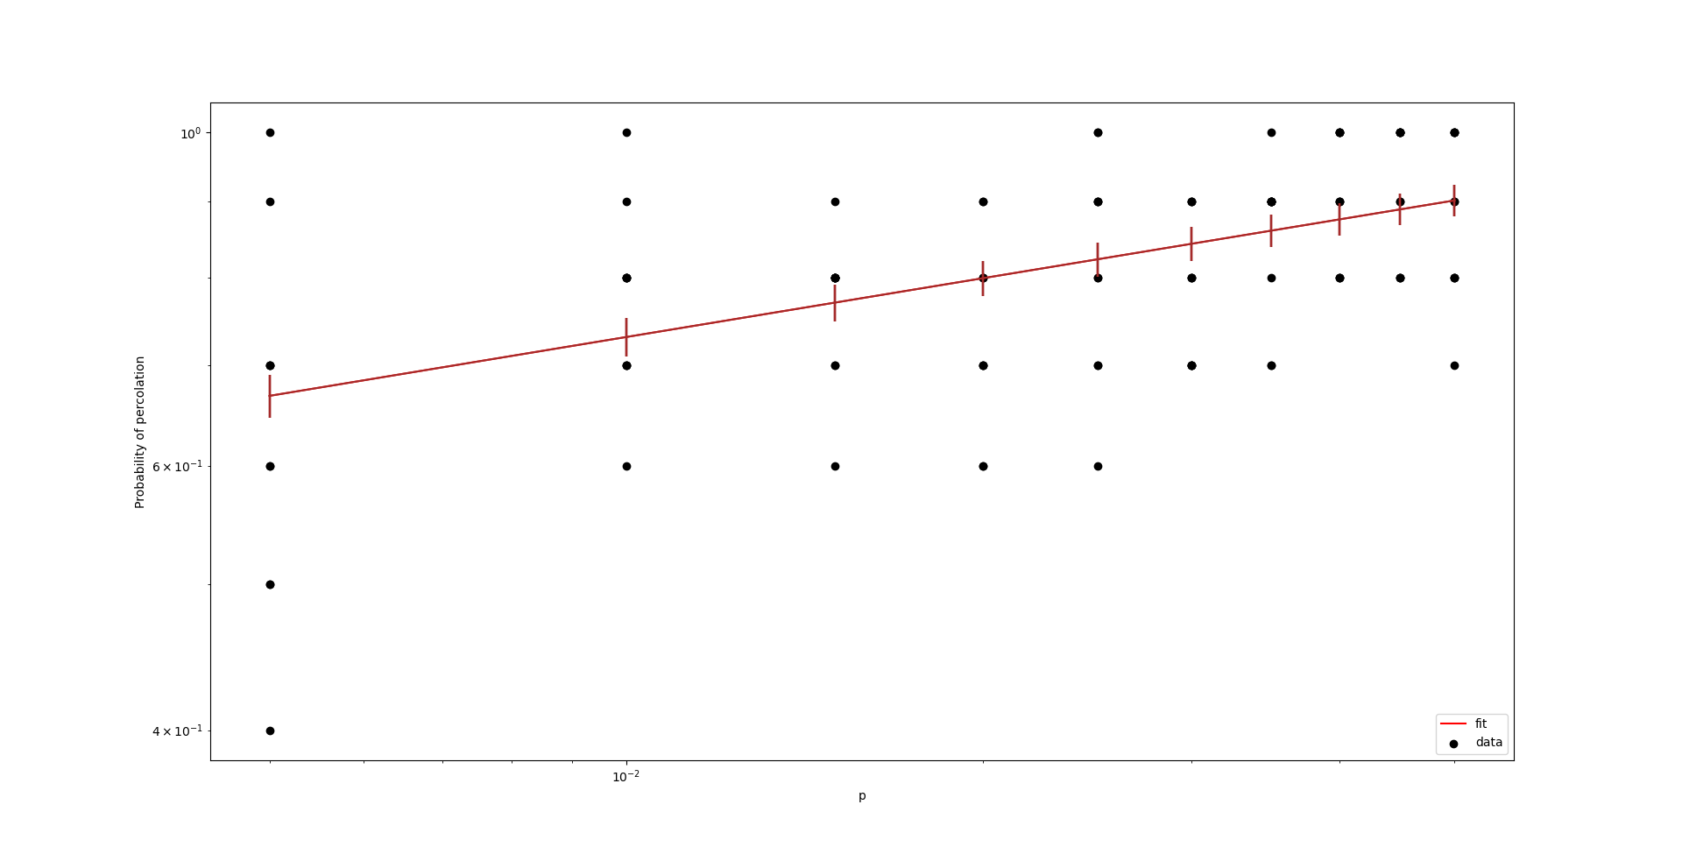
Exponent of critical area

